Slide 1


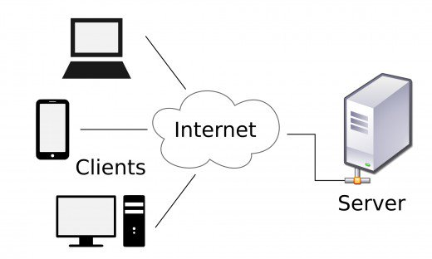
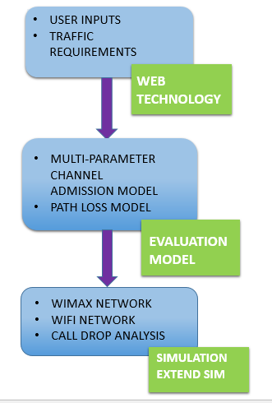
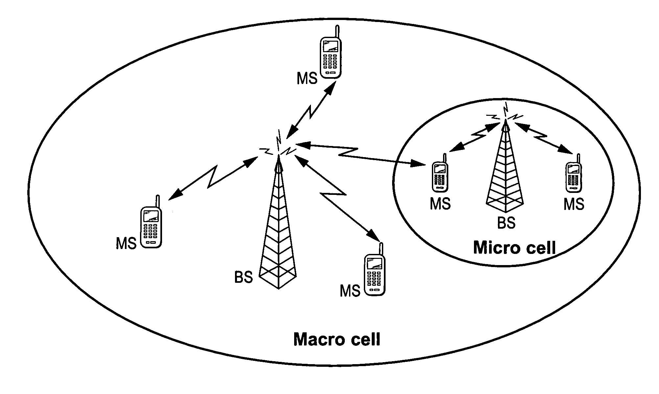





SSN Campus Network Performance Analysis Model
JEYA AISWARYA V, NIKITA V, LAHARI C, IIIrd year IT
Guided By
Ms. E.M Malathy, Ms. N.Radha, Assistant Professors
Department of Information Technology
SSN College of Engineering
SSN COLLEGE OF ENGINEERING.
Introduction
Working methodology
Concepts used
Project is proposed to analyze channel allocation and design an efficient network model.
Proposed client-server model will eliminate the call drop and provide maximum channel utilization.
Channel Allocation
Use of Web technologies
Designing model using Extend Sim Tool
Objectives
Requirements
To analyse the potentials of the Web technology environment to infer network characteristics.
To determine the client’s network conditions on call occurrence
To build network evaluation framework.
Hardware Requirements
Windows 8/10
Software Requirements
HTML5/CSS
PHP
EXTEND-SIM TOOL
User inputs like bandwidth, latency and traffic requirements got from the user through Web Technology.
Resource utilization is analysed.
Use Extend-Sim tool to design and implement both evaluation models.
After implementation, test the network models for call-drop probability using Extend-Sim tool.
Need for a network model
To analyse increase in call drop and failure.
To analyze the channel allocation to mobile users in WiFi and WiMAX network.
A
B
Hassles
Future scope
Poor Network Connectivity
Variations in the user inputs.
Improvisation of WIFI signal of college campus.
Optimization of network parameters for maximum throughput.

